Slide 1
FACE MASK AND SOCIAL DISTANCING DETECTION
NIDHA
S3 MCA-A

Slide 2
RELEVANCE OF THE TOPIC
Social distancing and face mask – this terms has taken the whole world for the last two years.
The biggest concern revolving is how quickly the infection spreads from person to person. Social distancing and face masks are key strategies to fight these.

Slide 3
DESCRIPTION OF THE PROJECT
This project is a deep learning based approach to identify whether a person maintain social distance and does/doesn’t wear masks. The input can be an image.
The project will be developed using Tensor Flow and Open CV programming ; they detect the face and evaluate the face point to detect whether the face has mask or not. If the person is wearing mask a green rectangle box with a safe alert and if the person isn’t wearing, a red rectangle box with alert comes up.

Slide 4
Social Distance detecting will detect that teo or more persons in a single frame are walking with social distance maintained with at least 0.8 meter of range with each other.
This is implemented using Euclidean Distance method. If social distance is not maintained red rectangular box with danger alert comes else a red box

Slide 5
OBJECTIVE
According to data obtained by the World Health Organization (WHO), the global pandemic of COVID-19 has severely impacted the world and has now infected more than eight million people worldwide. Wearing face masks and following safe social distancing are two of the enhanced that contributes to public safety, this project propose an efficient computer vision-based approach focused on the monitoring of people to detect both safe social violations through cameras.

Slide 6
PROPOSED SYSTEM
In this proposed system modern deep learning algorithm have been mixed with geometric techniques for building a robust modal which covers three aspects of detection, tracking and validation. Thus, the proposed system favours the society by saving time and helps in lowering the spread of corona virus. It can be implemented effectively in a situation when lockdown is eased to inspect persons in public gatherings, shopping malls, etc. Automated inspection reduces manpower to inspect the public and also can be used in any place.

Slide 7
MODULES
Understanding the problem
Dataset collection
Dataset preprocessing
Algorithm/development
Creating output stream to display

Slide 8
METHODS AND TECHNIQUES USED
TENSORFLOW
PYTHON
SCIKIT LEARN
OPEN CV
SciPy
YOLO V3
EUCLIDEAN DISTANCE
LIBRARIES-
Keras,matplotlib,opencv-python,pandas

Slide 9
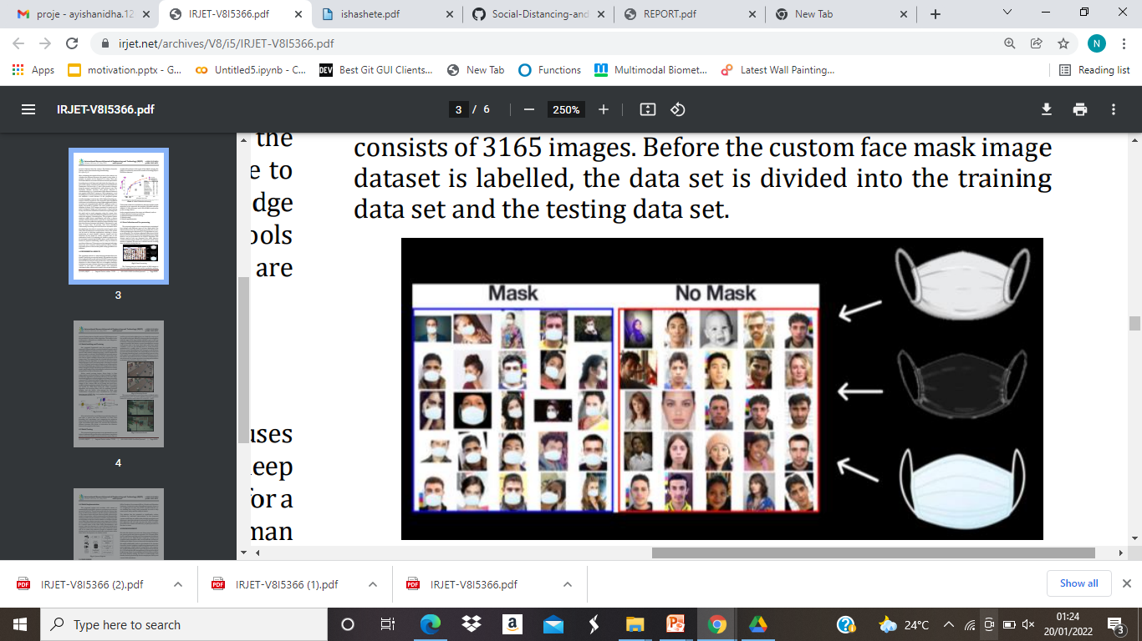
DATASETS
The proposed system uses a custom data set consisting of face images with different types of face Mask which are labelled and used for the training of the models

Slide 10
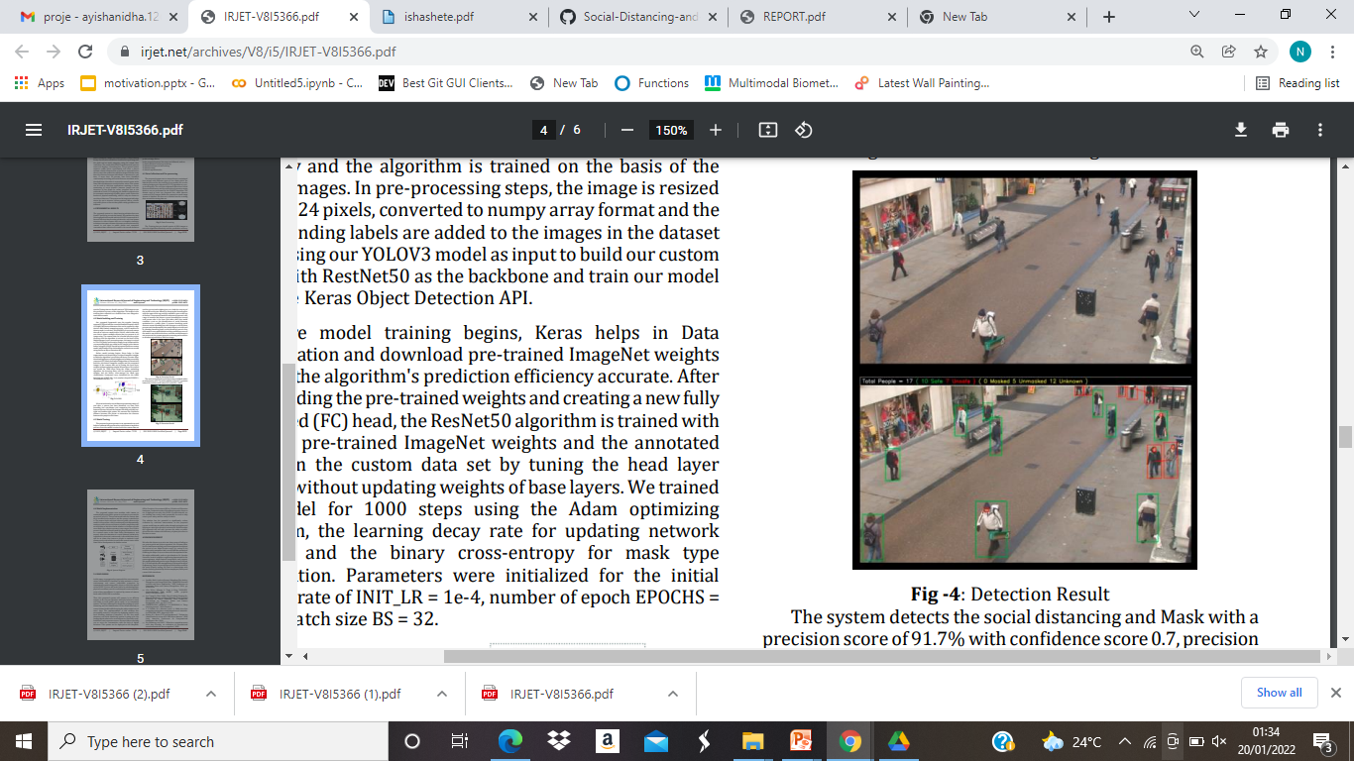
INPUT /OUTPUT

Slide 11
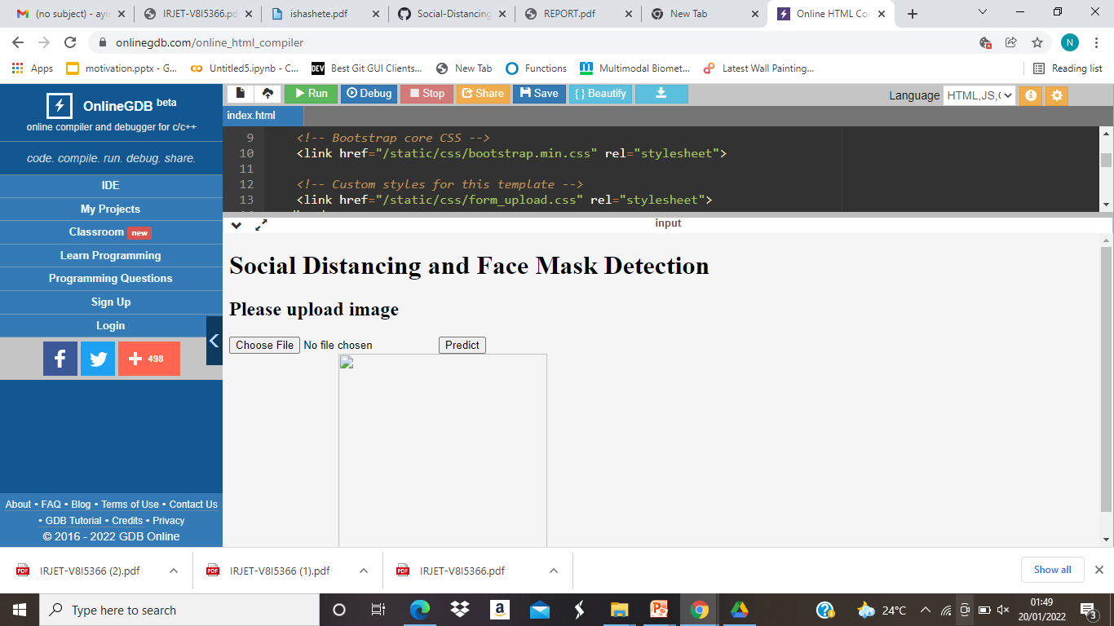
USER INTERFACE

